Slide 1
Visualization Artifacts
Josh Ness

Slide 2
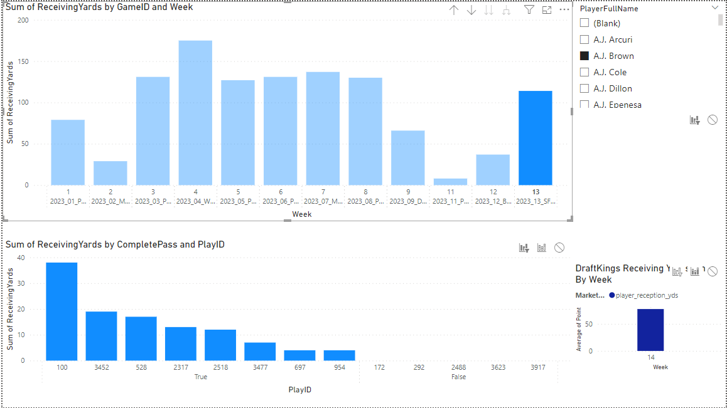
Receiving Yards Example
Here is an example of player receiving yards
- Top chart shows total yards for selected player(s) for each week
- Bottom chart shows yards gained per target, whether the ball was caught or not
- Bottom right shows Betting Lines for the players receiving yards by week
- Data only starts since week 14 for this, so in the future it will be easy to see whether players have been hitting their lines
- Market can be receiving yards, rushing yards, passing yards, or just about anything. A slicer to select the market will be added, that can be used to control the entire pages target category.
Here, we quickly see A.J. Brown had 114 receiving yards in week 13, while only catching 8/13 targets. That is good target share, and yardage is consistent with most of the season.
The betting line for next week is 77.5 yards, possibly lower due to a couple bad performances in weeks 11 and 12 that are for the most part, outliers. Expecting A.J. Brown to go over 77.5 yards in week 14 seems reasonable

Slide 3
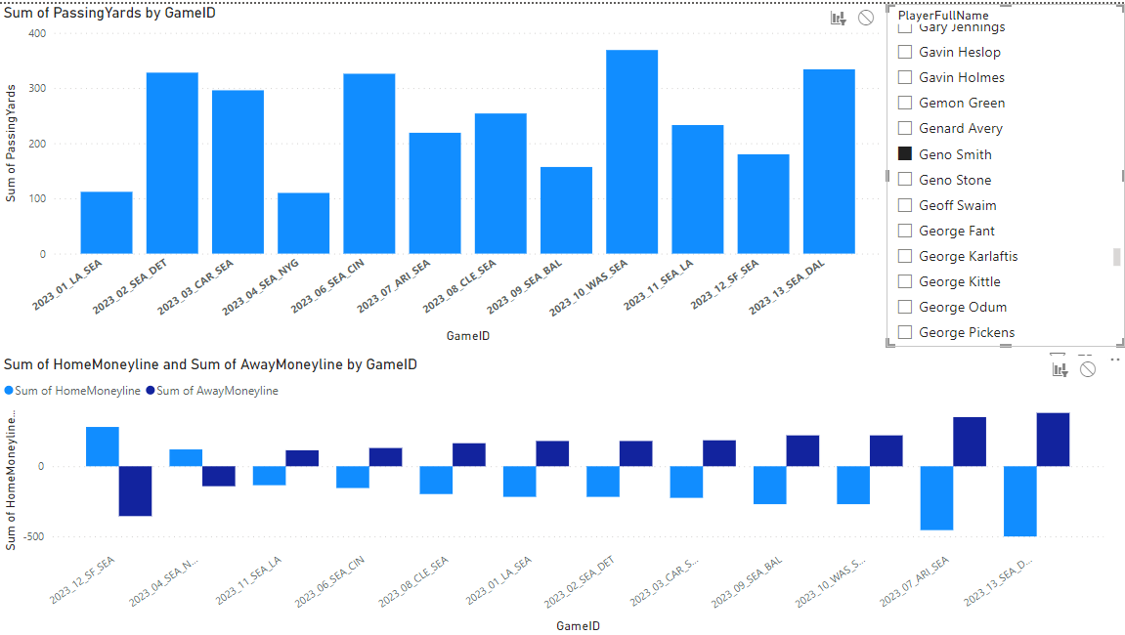
Game Odds Analysis
This example graphic requires some more understanding of betting terminology, as well as an understanding of gameID and its format. The visualizations in the future will be improved to eliminate confusion.
The plan for this graphic is to combine each graph into one, which would allow easy analysis of what effects being an underdog might have on a player's performance, such as increased passing yards.
In the preview to the right, I have game odds / moneyline shown at the bottom. A team with a moneyline above 0 is expected to win, below 0 means the opposite. The amount above/below 0 indicates the severity of the expectations.
Unfortunately, the visualization is not fully developed yet and to use the odds you must understand the GameID format is as follows: Season_Week_AwayTeam_HomeTeam
With this understanding, you can check a teams predictions compared to various player stats for any game. This will be simplified in the future.

